Slide 1
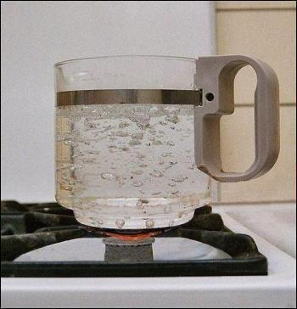
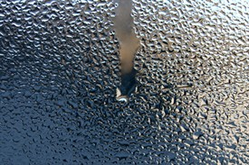
Heat Transfer
Boiling and Condensation

Slide 2
Introduction
There are many important practical cases which involve heat transfer with a change of phase of the fluid,
e.g. boiling where the liquid changes to vapour and condensation where the vapour condenses into a liquid
Boiling and condensation are classified under convection since there is motion of the fluid during heat transfer in these processes.
Some of the applications of boiling and condensation are:
Evaporators and condensers of a refrigerating system
Boilers and condensers of a steam power plant
Reboilers and condensers of distillation columns of cryogenic and petrochemical plants
Cooling of nuclear reactors and rocket motors
Unique features of boiling and condensation are:
heat transfer, practically at a constant temperature, because of change of phase
high heat transfer rates with small temperature difference.

Slide 3
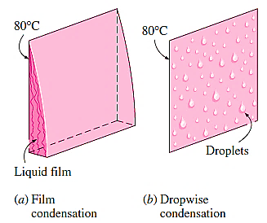
CONDENSATION HEAT TRANSFER
Whenever a saturated vapour at a temperature T_{sat} is brought in contact with a surface maintained at temperature T_{s} such that T_{s} is less than T_{sat} vapours condense on the surface.

Slide 4
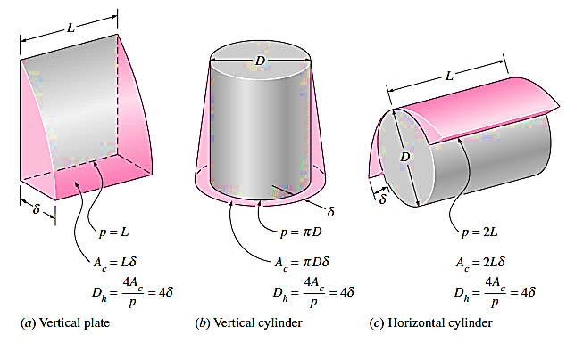
Film Condensation and Flow Regimes
Thickness of the film is zero at the top of the plate and increases as we travel down the plate due to additional condensation of vapour.
Initially, the liquid film flow is laminar; after some distance it will become wavy and later, it may even turn turbulent. These different flow regimes are identified according to a 'film Reynolds number', defined as follows:
$${Re}_{f}=\frac{D_{L} . ρ_{L} .V_{L}}{μ_{L}}$$
$$=\frac{{4 .A}_{c} . ρ_{L} .V_{L}}{P . μ_{L}}=\frac{{4 . }_{ } ρ_{L} .V_{L} .δ}{ μ_{L}}=\frac{4 .m}{P . μ_{L}}$$

Slide 5
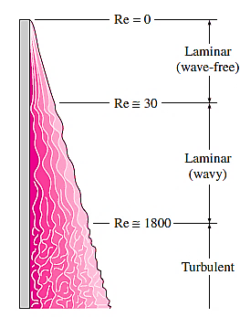
sub-cooling of the liquid can be taken into account by replacing h_{fg} by a 'modified latent heat of vaporisation $h_{fg}^{,}$ defined as:
$$h_{fg}^{,}=h_{fg}^{ }+0.68 C_{pL} (T_{sat}−T_{s})$$
Similarly, if a superheated vapour at a temperature, T_{v}, enters a condenser and condenses, the superheated vapour has to be cooled to T_{sat} first, and then condensed at T_{sat} and then sub-cooled to some temperature between T_{s} and T_{sat} Then, modified latent heat of vaporisation is:
$$h_{fg}^{,}=h_{fg}^{ }+0.68 C_{pL} \left(T_{sat}−T_{s}\right)+C_{pV} (T_{v}−T_{sat})$$
Then, rate of heat transfer in condensation becomes:
$$Q_{conden}=h .A.\left(T_{sat}−T_{s}\right)=m .h_{fg}^{,}$$

Slide 6
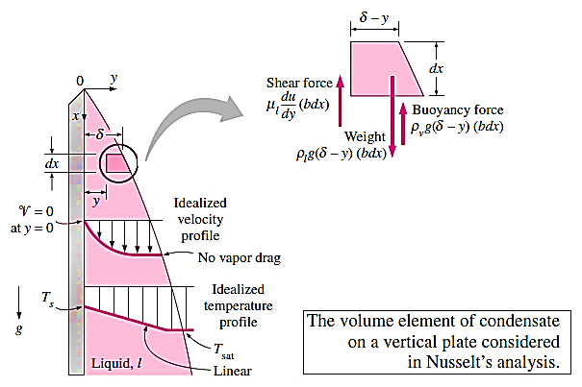
Nusselt's Theory for Laminar Film Condensation on Vertical Plates
Nusselt made the following simplifying assumptions in his analysis:
Flow of liquid film is laminar
Heat flow is mainly by conduction through the liquid film
Temperature is T_{s} at the liquid-plate interface and T_{sat} at the liquid-vapour interface and the temperature gradient between them is linear
Velocity of vapour is low, i.e. there is no viscous shear force at the liquid-vapour interface
Properties of the liquid are constant.

Slide 7
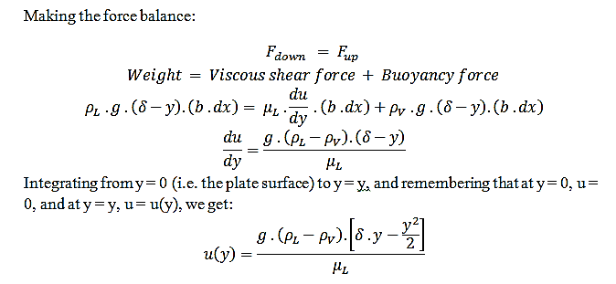
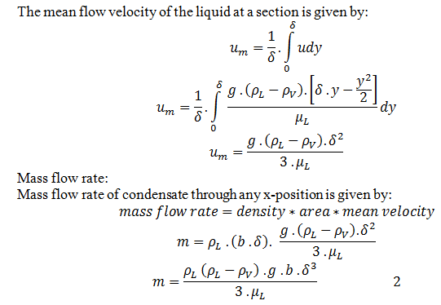

Slide 8
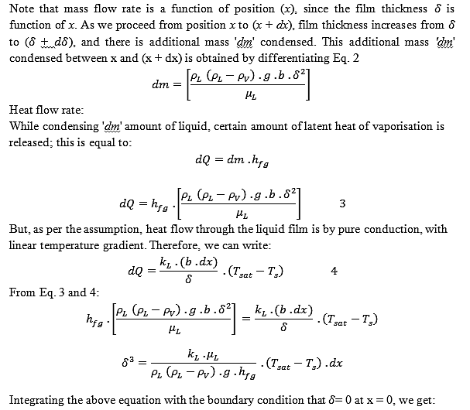

Slide 9
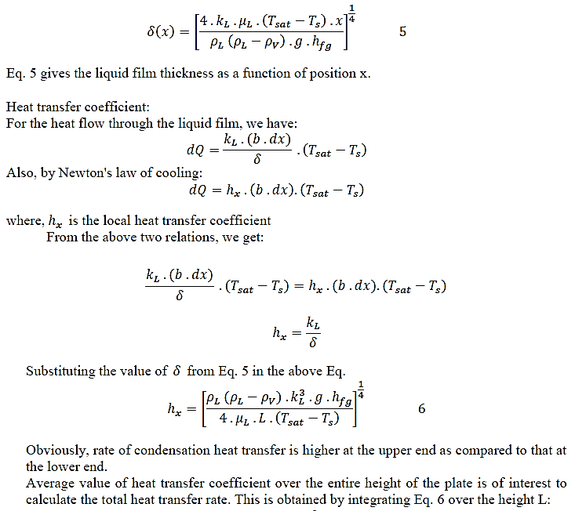

Slide 10
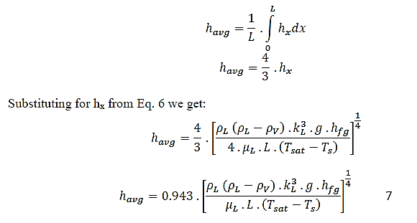
$$h_{avg}=0.943 .{\left[\frac{ρ_{L} \left(ρ_{L}−ρ_{V}\right) . k_{L}^{3} .g .h_{fg}^{′}}{μ_{L} .L .\left(T_{sat}−T_{s}\right)}\right]}^{\frac{1}{4}} 8$$

Slide 11
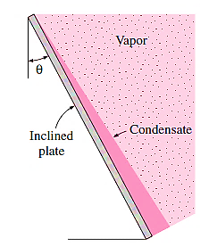
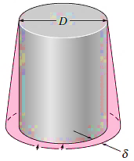
Film Condensation on Inclined Plates, Vertical Tubes, Horizontal Tubes and Horizontal Tube Banks
Inclined plates:
$$h_{inclined}=0.943 .{\left[\frac{ρ_{L} \left(ρ_{L}−ρ_{V}\right) . k_{L}^{3} .g.cos(θ) .h_{fg}^{′}}{μ_{L} .L .\left(T_{sat}−T_{s}\right)}\right]}^{\frac{1}{4}} 9$$
Vertical tubes:
Eq. 8 for laminar condensation on vertical plates can also be used
the outer or inner surface of a vertical tube
. if D >> $δ$

Slide 12
Horizontal tube-laminar film condensation:
$$h_{horiz.}=0.729 .{\left[\frac{ρ_{L} \left(ρ_{L}−ρ_{V}\right) . k_{L}^{3} .g .h_{fg}^{′}}{μ_{L} .D .\left(T_{sat}−T_{s}\right)}\right]}^{\frac{1}{4}}$$
horizontal tubes on a matrix containing N tubes
$$h_{horiz.}=0.729 .{\left[\frac{ρ_{L} \left(ρ_{L}−ρ_{V}\right) . k_{L}^{3} .g .h_{fg}^{′}}{μ_{L} .N.D .\left(T_{sat}−T_{s}\right)}\right]}^{\frac{1}{4}}$$

Slide 13
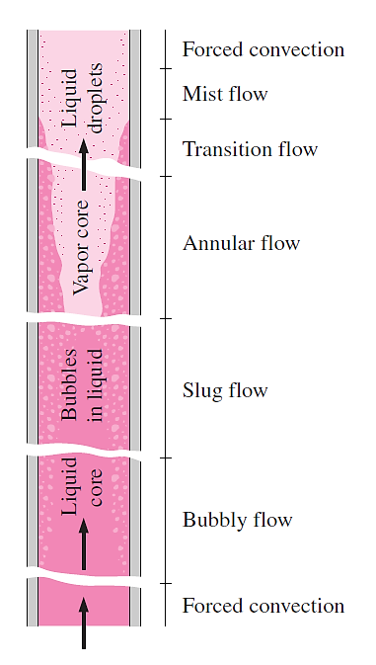
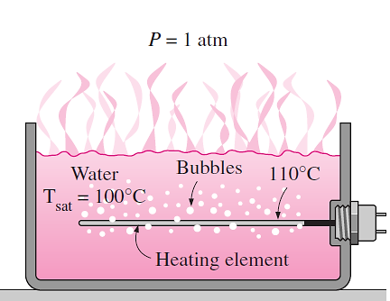

Slide 14
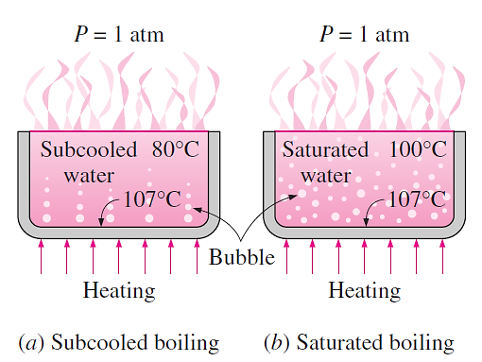

Slide 15
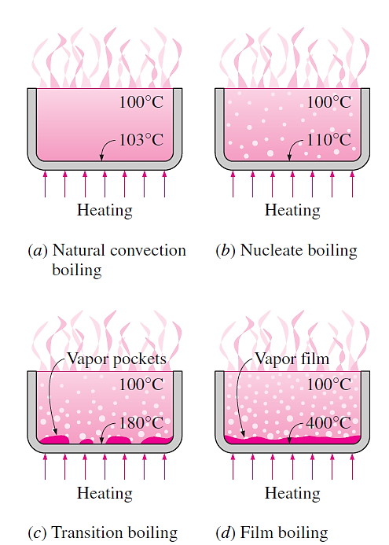

Slide 16
